Slide 1
Blockchain technology PROOF OF WORK
By Nandan Manjunath immadisetty

Slide 2
What is proof of work
Proof of Work (POW) is a consensus mechanism used in blockchain networks to achieve agreement and secure the network.
It is one of the blockchain's most well-known and widely used consensus algorithms.
It is based on solving a complex mathematical puzzle, and on solving you can create a block in the blockchain.

Slide 3
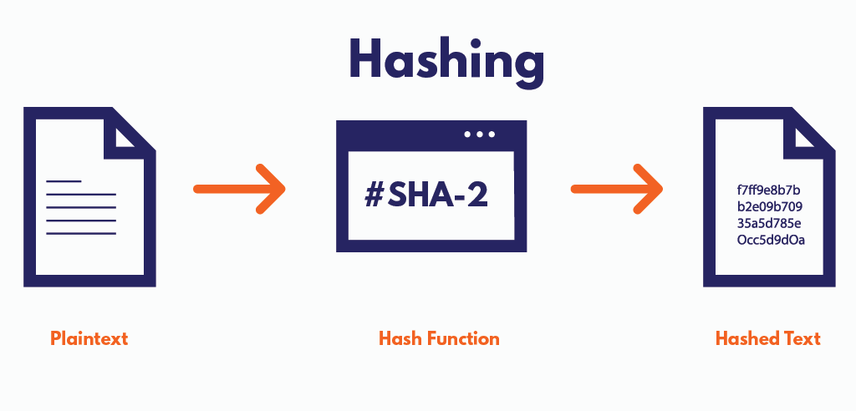
Hash function
Properties of this function are
Input can be of any bits, but the output is of constant bitsize.
Given the input, the output can be easily calculated.
Collision resistive: It is computationally infeasible to find two unequal inputs, x1 and x2, such that H(x1)=H(x2).
A hash function H is said to be hiding when a secret value r is chosen from a probability distribution that has high min-entropy; then, given H(r||x), it is infeasible to find x.
Currently we are using HSA-256 function.

Slide 4
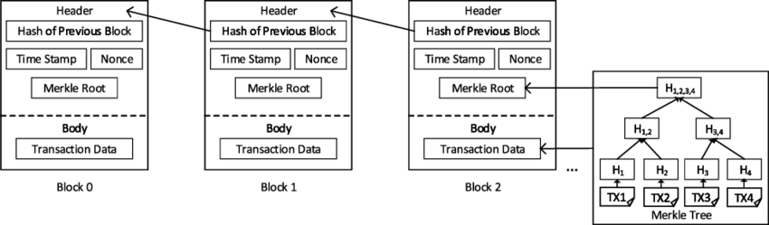
Structure of a block

Slide 5
Threshold value
To add a block, we need to find nonce values such that the hash function of the block header is less than the threshold value.
Threshold values are determined after every 2016 blocks and it is updated based on the difficulty and average time taken to create a block.
If the threshold value is more, it is easy to create a block and vice-versa.
Threshold is adjusted such that the average time taken for a block to be generated is 10 minutes.

Slide 6
Working of Proof of work
Miners continuously try to solve the problem by changing nonce values and checking whether the hash value is less than the threshold.
It requires a lot of hardware and electricity, and in return, after creating a block the miner is awarded a mining fee from the transaction fees of the transaction included in the block.
The mining process continues, and new blocks are added to the blockchain in a sequential and irreversible manner, creating a secure, decentralized, and trustless ledger of transactions

Slide 7
Draw-Backs of POW
High electricity bill and high-level hardware is required.
The Bitcoin network uses almost close to 200 terawatt-hours (TWh)
Centralized tendencies: people having higher level of hardware and cheap electricity have an edge over all others.
A single entity or a group of colluding miners controls more than 50% of the network's total computational power (hash rate). They could potentially manipulate the blockchain's history, double-spend coins, or censor transactions

Slide 8


